Slide 1
NAV CANADA Technology & Technologist Briefing
Insights into advancements in aviation technology systems

Slide 2

Presentation Overview
Technological Advancements
NAV CANADA has implemented innovative technologies to modernize air traffic services and improve operational efficiency.
Drone Integration
Strategic initiatives include integrating drone operations safely into existing airspace management.
Workforce Optimization
Digital transformation and automation are optimizing workforce capabilities and enhancing productivity within NAV CANADA.

Slide 3
Strategic Initiatives
Notes:
Strategic Overview

Slide 4

Strategic Overview
Digital Transformation
NAV CANADA is modernizing air traffic services through advanced digital technologies to improve safety and efficiency.
Drone and Autonomous Integration
The organization integrates drones and autonomous systems to adapt to new aviation challenges and enhance airspace management.
Workforce Optimization
AI and predictive tools are used to optimize workforce performance and ensure adaptability in the aviation sector.
Notes:
NAV CANADA has accelerated its modernization strategy to meet the evolving demands of the aviation industry. The organization is focusing on three core areas: digital transformation of air traffic services, integration of drones and autonomous systems, and workforce optimization through AI and predictive tools. These initiatives are designed to enhance safety, efficiency, and adaptability in a rapidly changing aviation landscape. By embracing innovation and aligning with global standards, NAV CANADA aims to maintain its leadership in air navigation services.

Slide 5
Drone Integration
Notes:
--- This slide references information from the following file: https://www.cantechletter.com/newswires/nav-canada-launches-major-nav-drone-update/ NAV Drone App Update

Slide 6

NAV Drone App Update
App Update and Regulations
The NAV Drone app update aligns with new Transport Canada rules enhancing drone operation capabilities.
Advanced Drone Operations
New features support (Beyond Visual Line-of-Sight) BVLOS, (Extended Visual Line-of-Sight) EVLOS with observers, and medium drone operations for commercial use.
Commercial Applications
Applications include precision agriculture and infrastructure inspection using drones between 25 and 150 kg.
RTM Initiative Goals
The RTM initiative ensures safe drone integration into airspace while unlocking economic opportunities.
Drone Incursion & No direct ATSEP involvement
Still no solution for drone incursion for controlled airspace. No direct consultation NAV CANADA Technologist (ATSEP).
Notes:
--- This slide references information from the following file: https://www.cantechletter.com/newswires/nav-canada-launches-major-nav-drone-update/ On November 4, 2025, NAV CANADA launched a major update to its NAV Drone app, coinciding with new Transport Canada regulations. The update enables drone operators to conduct complex operations such as Beyond Visual Line-of-Sight (BVLOS) in uncontrolled airspace, Extended Visual Line-of-Sight (EVLOS) with certified observers, and medium drone operations (25–150 kg) for commercial applications like precision agriculture and infrastructure inspection. These enhancements are part of the Remotely Piloted Aircraft Systems Traffic Management (RTM) initiative, which aims to safely integrate drones into Canadian airspace and unlock economic potential.

Slide 7
Digital Air Traffic Facility
Notes:
--- This slide references information from the following file: https://www.newswire.ca/news-releases/innovation-takes-flight-nav-canada-breaks-ground-on-canada-s-first-digital-air-traffic-facility-in-kingston-899433978.html Kingston Pilot Project

Slide 8
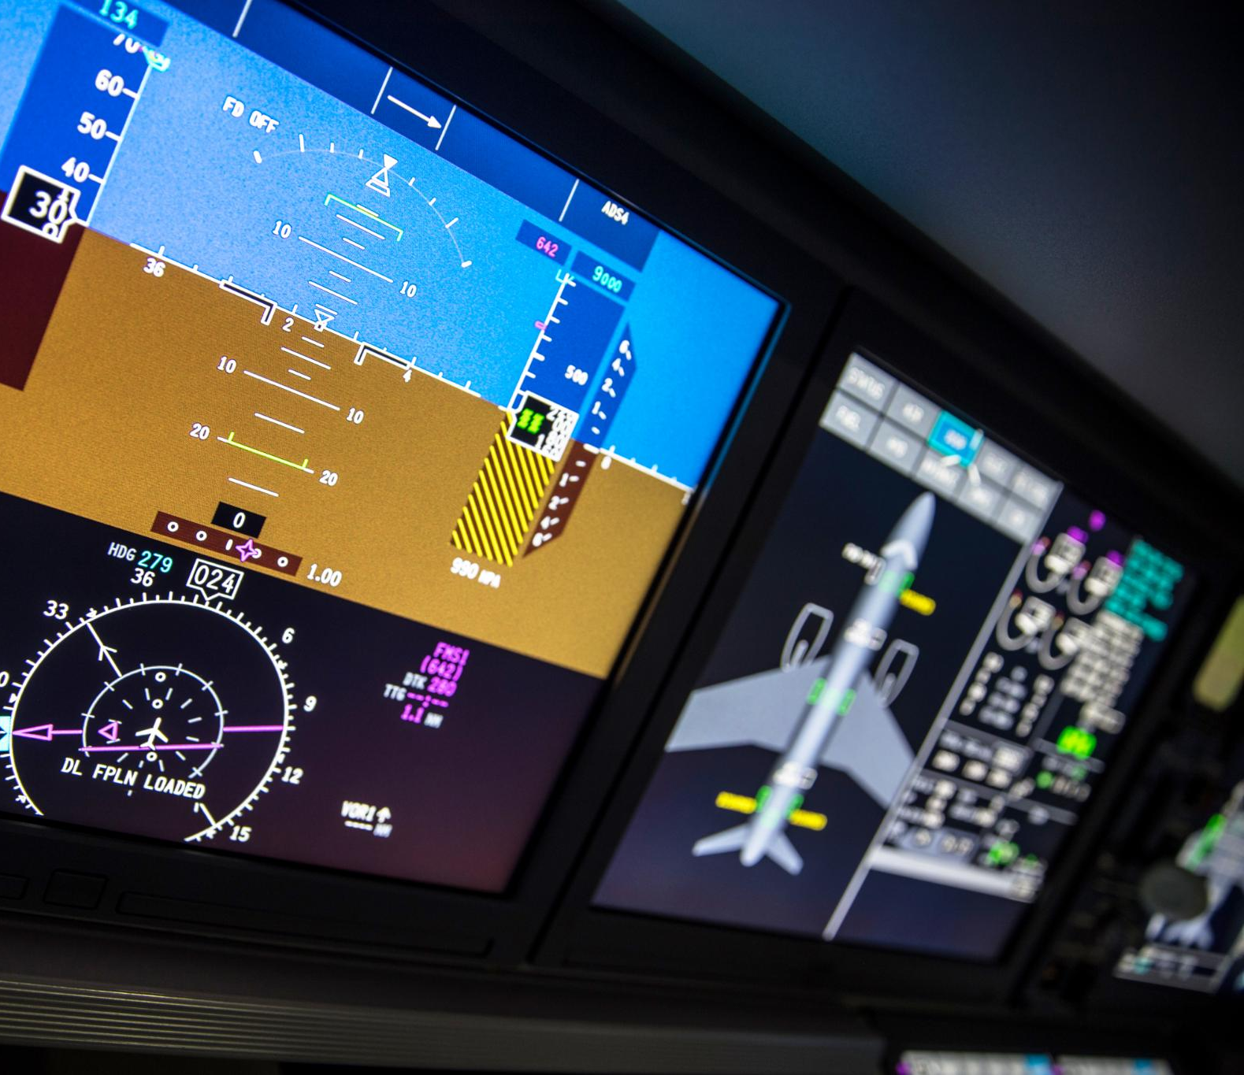
Kingston Pilot Project
Digital Air Traffic Facility
Kingston hosts Canada’s first digital air traffic facility to validate advanced aviation technologies. Currently 2 ATSEPs staffed at site.
Remote Airport Management
The facility will enable remote management of up to 20 airports through Digital Aerodrome Air Traffic Services hubs.
Enhanced Operational Capabilities
Integration of high-resolution sensors and secure networks improve situational awareness and operational efficiency.
Aviation Innovation Milestone
This pilot project marks a key step in evolving air navigation services in line with global aviation trends.
New Site Announced
Hamilton Tower Selected as Second Digital Facilities Site.
Notes:
--- This slide references information from the following file: https://www.newswire.ca/news-releases/innovation-takes-flight-nav-canada-breaks-ground-on-canada-s-first-digital-air-traffic-facility-in-kingston-899433978.html NAV CANADA has initiated the construction of Canada’s first digital air traffic facility in Kingston, Ontario. This temporary site will validate technologies for future Digital Aerodrome Air Traffic Services (DAATS) hubs, which will eventually manage up to 20 airports remotely. The Kingston Digital Facility combines high-resolution sensors, secure data networks, and advanced digital displays to enhance situational awareness and operational capabilities. This pilot project is a critical milestone in reimagining air navigation services and aligns with global trends in aviation innovation.

Slide 9
Technologist Workforce
Notes:
--- This slide references information from the following file: https://www.navcanada.ca/en/careers/technical-services-technologist.aspx,https://tc.canada.ca/en/binder/13-nav-canada-staffing-issues Roles and Strategy

Slide 10
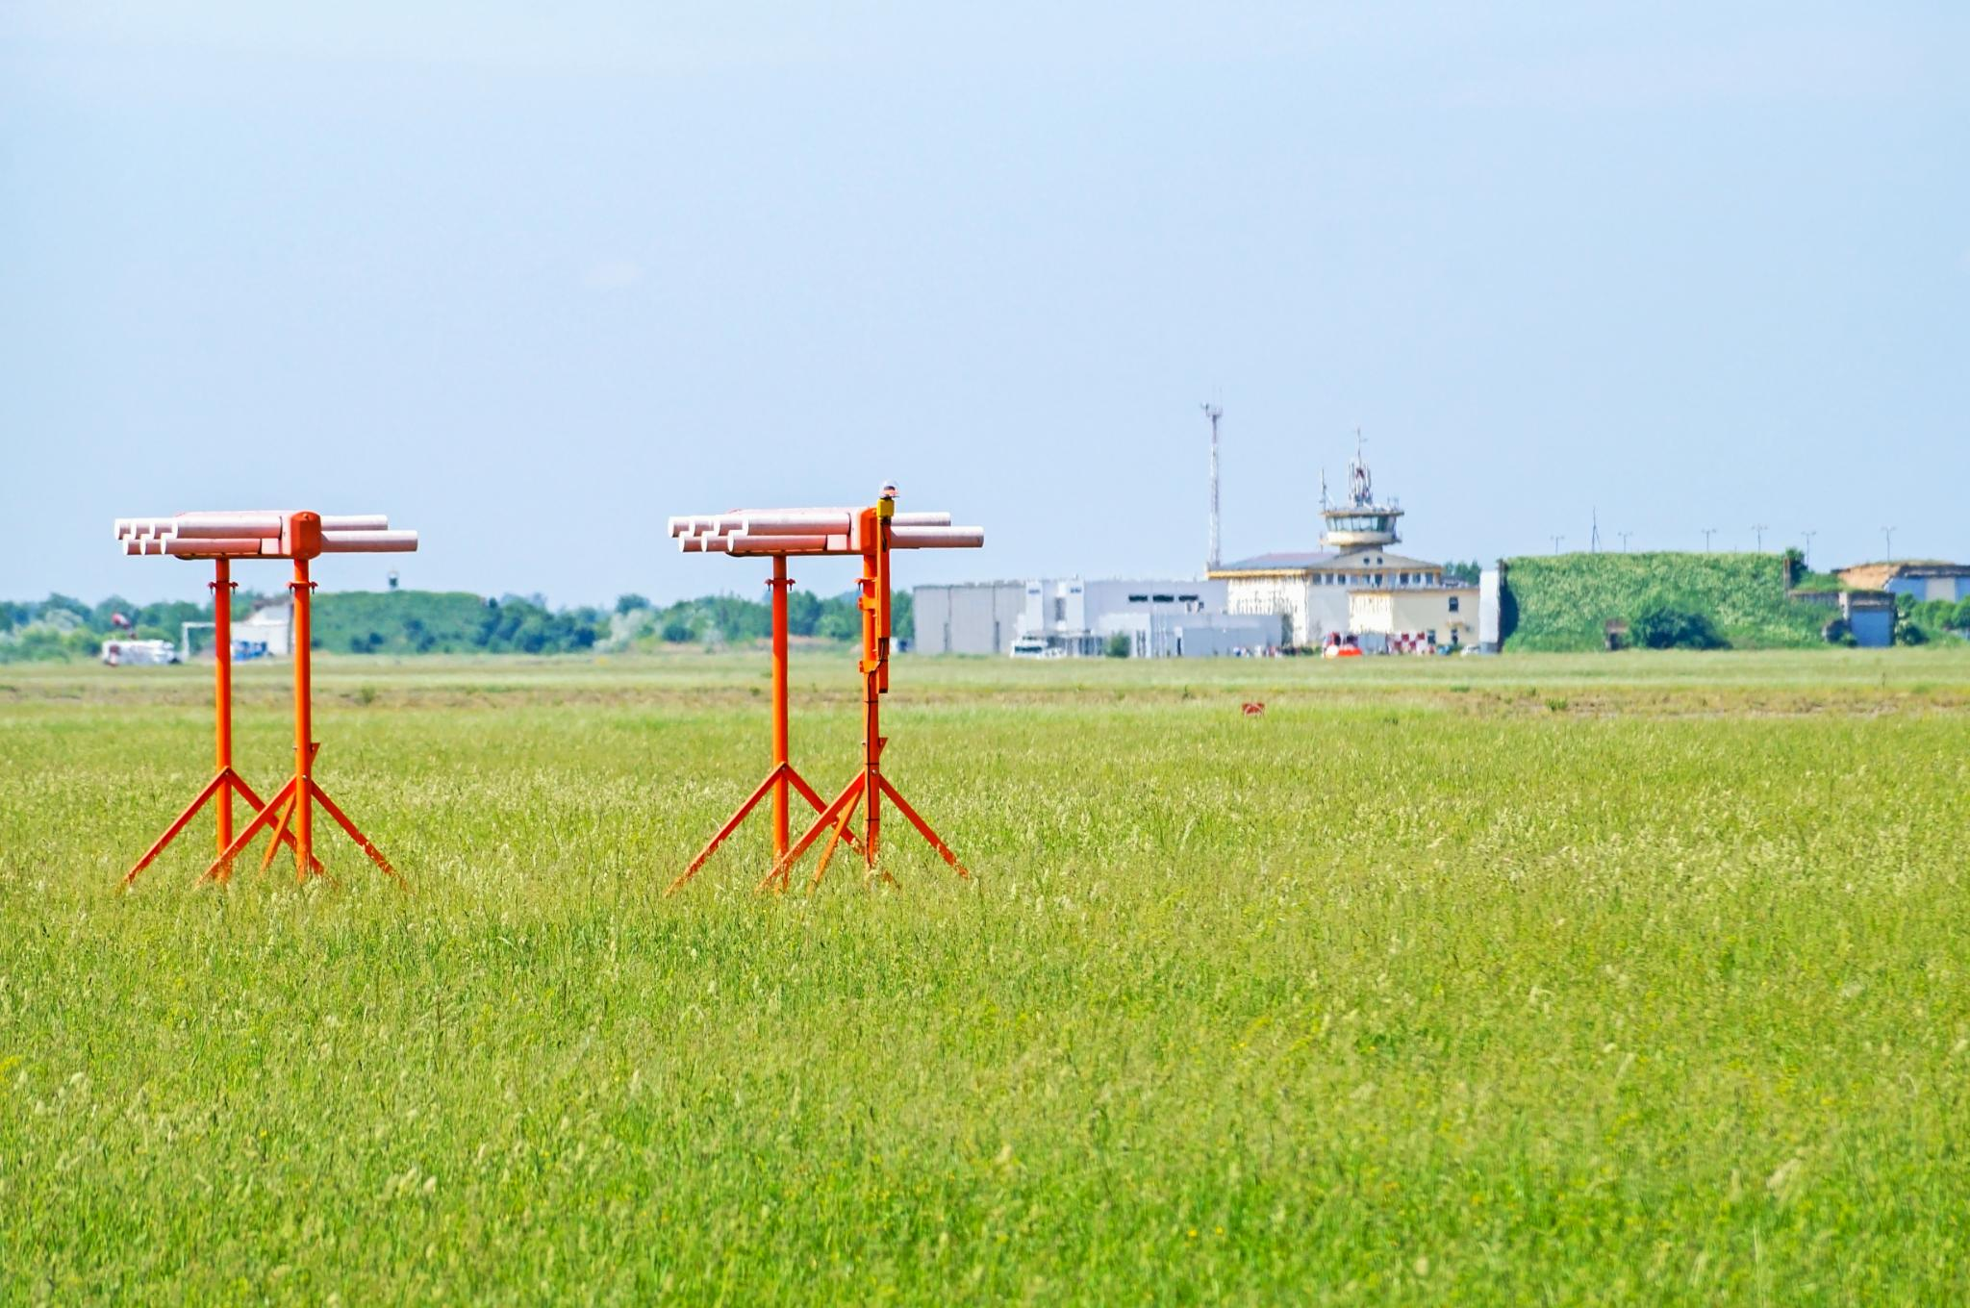
CURRENT CHALLENGES
Air Traffic Management
ATM technologists maintain radar displays, flight tracking systems, and network infrastructure to ensure safe air traffic control. Currently severe staff shortages at some sites. Difficult time retaining staff.
Communications Navigation Surveillance
CNS technologists support radar systems, landing aids, and radio communications, often in remote and challenging locations. Lack of training plaquing staff.
Technical Deployment
Installation team of technologists led by project leads; relies on ATM and CNS staff for support; significant backlog of installation projects currently in progress.
Notes:
--- This slide references information from the following file: https://www.navcanada.ca/en/careers/technical-services-technologist.aspx,https://tc.canada.ca/en/binder/13-nav-canada-staffing-issues NAV CANADA continues to invest in its technical workforce, focusing on two key streams: Air Traffic Management (ATM) and Communications, Navigation, and Surveillance (CNS). ATM technologists maintain radar displays, flight tracking systems, and network infrastructure, while CNS technologists support radar systems, landing aids, and radio communications, often in remote locations. To address staffing shortages, NAV CANADA has adopted a dual-track strategy involving recruitment and training, as well as leveraging automation and predictive tools to reduce operational strain and enhance efficiency.

Slide 11

Current CNS Upgrades
Intelcan DME
Deploying Intelcan DME nationwide to replace aging infrastructure with SKY NAV SERIES N9000.
Thales VOR
Rolling out Thales DVOR 532 across Canada to replace outdated systems.
Raytheon Secondary Radar
ngoing deployment of Raytheon Condor Mk 3 as secondary radar at multiple locations across Canada.
Notes:
--- This slide references information from the following file: https://www.navcanada.ca/en/careers/technical-services-technologist.aspx,https://tc.canada.ca/en/binder/13-nav-canada-staffing-issues NAV CANADA continues to invest in its technical workforce, focusing on two key streams: Air Traffic Management (ATM) and Communications, Navigation, and Surveillance (CNS). ATM technologists maintain radar displays, flight tracking systems, and network infrastructure, while CNS technologists support radar systems, landing aids, and radio communications, often in remote locations. To address staffing shortages, NAV CANADA has adopted a dual-track strategy involving recruitment and training, as well as leveraging automation and predictive tools to reduce operational strain and enhance efficiency.

Slide 12
Trajectory-Based Operations
Notes:
--- This slide references information from the following file: http://www.avcanada.ca/forums2/viewtopic.php?t=150845,https://www.navcanada.ca/en/corporate/annual-report-2024/building-towards-tomorrows-airspace.aspx TBO Transition

Slide 13

TBO Transition
Trajectory-Based Operations
TBO focuses on predictive routing and improves fuel efficiency while reducing air traffic controller workload through automation.
System Modernization Partnership
NAV CANADA collaborates with technology partners to replace legacy systems with advanced flight data processors and traffic flow tools.
Enhanced Air Traffic Management
The transition supports safer, more efficient, and responsive air traffic management aligned with global aviation standards.
Target site Edmonton ACC.
Notes:
--- This slide references information from the following file: http://www.avcanada.ca/forums2/viewtopic.php?t=150845,https://www.navcanada.ca/en/corporate/annual-report-2024/building-towards-tomorrows-airspace.aspx NAV CANADA is transitioning toward Trajectory-Based Operations (TBO), a global standard mandated by ICAO. TBO emphasizes predictive routing, fuel efficiency, and reduced controller workload through automation. NAV CANADA has partnered with Indra to replace legacy systems with advanced flight data processors and traffic flow management tools. This transition supports safer, more efficient, and responsive air traffic management systems and aligns with international best practices for modern aviation infrastructure.

Slide 14
Digital Optimization
Notes:
--- This slide references information from the following file: https://www.navcanada.ca/en/news/blog/modernizing-canadian-airspace-how-nav-canada-is-using-digital-twin-technology-to-shape-the-future-of-aviation.aspx Digital Twin Technology Deployment

Slide 15
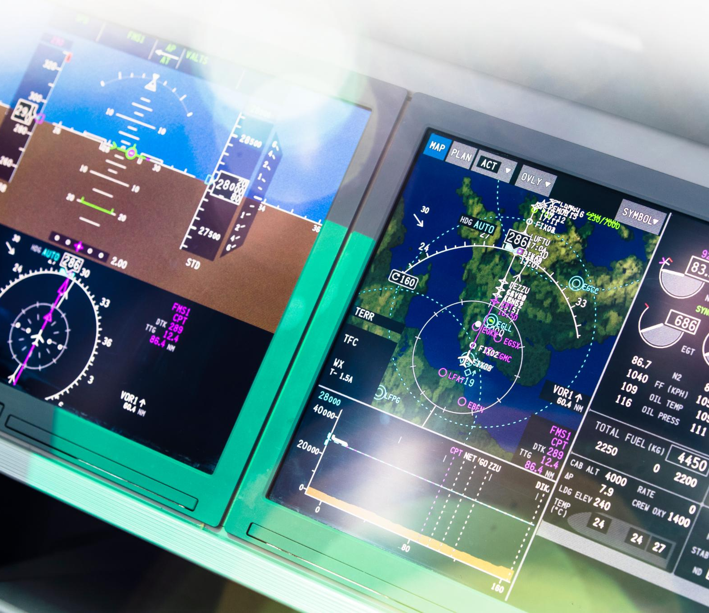
Digital Twin Technology Deployment
AI-Powered Airspace Simulation
The Digital Twin tool uses AI to simulate airspace operations based on historical data for accurate predictive insights.
Advanced Flight and Task Forecasting
DT-SPO forecasts flight schedules, controller tasks, and sector configurations up to 30 hours ahead to enhance planning.
Optimized Resource and Coverage Planning
Integrating flight data with employee scheduling optimizes coverage and service delivery for operational efficiency.
Enhanced Efficiency and Resilience
Deployment of DT-SPO builds operational resilience and supports proactive resource management in air traffic control.
Notes:
--- This slide references information from the following file: https://www.navcanada.ca/en/news/blog/modernizing-canadian-airspace-how-nav-canada-is-using-digital-twin-technology-to-shape-the-future-of-aviation.aspx NAV CANADA has implemented the Digital Twin–Sector Performance Optimizer (DT-SPO) across all Area Control Centres. This AI-powered tool simulates airspace operations using historical data and provides predictive insights to support daily decision-making. DT-SPO forecasts flight schedules, controller tasks, and sector configurations up to 30 hours in advance. It integrates airspace and flight data with employee scheduling to optimize coverage and service delivery. This deployment enhances operational efficiency, builds resilience, and supports proactive resource planning.

Slide 16
Conclusion
Notes:
Summary and Next Steps

Slide 17

Summary and Next Steps
Commitment to Safety and Innovation
NAV CANADA prioritizes safety and innovation in its technology roadmap to enhance air navigation services.
Digital Tower Pilot Monitoring
Ongoing evaluation of the Kingston digital tower pilot to improve remote air traffic management.
Drone Integration Expansion
Expanding capabilities to integrate drones safely into controlled airspace.
AI-Driven Airspace Optimization
Using AI technology to optimize airspace operations and improve efficiency.
Notes:
NAV CANADA’s technology roadmap reflects a strong commitment to safety, innovation, and operational efficiency. The organization will continue to monitor outcomes from the Kingston digital tower pilot, expand drone integration capabilities, and enhance airspace operations through AI-driven optimization. These initiatives position NAV CANADA as a leader in modern air navigation services and ensure readiness for future aviation challenges.

