Slide 1
MEDIA AND PR COMMITTEE
Annual Americas Regional Meetings
Notes:
Hello everyone
As a bit of disclaimer I have spent the past 8 months in bargaining with the ANSP for the ATSEP contract. I have current demographic information, current mitigating factors for the membership, and a look at where Canada's ATSEPs are with regards to basic training and licensing.

Slide 2


Current State
Re-formed after 2024 GA in Las Vegas
Members from all regions as well as Treasurer
Chaired by Executive Secretary
Notes:
Bit of the basics just for those who may not be aware.
Read slide

Slide 3
-
Terms of Reference
Purpose/Aims
This committee will disseminate information to IFATSEA affiliates, corporate membership and other international aviation employee organizations. The committee shall also create and distribute media for outreach and recruitment purposes. The committee shall also maintain the official IFATSEA website and official IFATSEA social media accounts ( LinkedIn, Facebook, Twitter, etc)
Notes:
We have been told that the membership can be expected to grow according to the employers projections over the coming few years by at least 100 ATSEPs.
Tec0 - 50
Tec1 - 230
Tec2- 230
Tec3- 90

Slide 4

  Goals
1. Information
2. Recruitment
3. Retention
4. Engagement
  Deliverables
1. Media Releases
2. Social Media
3. Website Content
4. Slideshow for GA/events
Notes:
I have spent much of the past year in collective bargaining as our contract was set to expire at the end of 2023.
Michel Gaulin was also very much involved in this process and may be able to help me answer any questions you might come up with.
We had about 8 months of bargaining to get to this tentative settlement. Since it is currently in ratification I can't speak to whether the process is actually finished for us or not. But this is where we are.
The employer came to the table with the need for increased flexibility.
The union negotiating team faced some very difficult decisions this round as the membership clearly was demanding higher wages, but things like contracting out and employment security continues to be an issue for us. At times, the union faced the difficult position of having to decide between what the membership has said they want versus what the union knows would be in the membership's own good.

Slide 5
Events Calendar
ATSEP Day
International Women’s Day
Affiliate Anniversaries
Regional Meetings
General Assembly
ICAO Events
Notes:
Pandemic-
1. The ANSP obviously suffered hugely during the pandemic. As we all know traffic went down to basically 0.
Because of this the ANSP asked the unions to agree to defer any negotiated wage increases for the upcoming 3 years which was the length of the contract, and in return they would not proceed with a workforce adjustment.
This request went for a membership vote which caused an enormous uproar from the membership, in every way you can imagine.
IBEW voted the deferral down. Only one union voted to defer their wages.
- Subsequently we went through the WFA and lost approximately 40 members
- many were hired back afterwards
- but like many organizations the membership has faced a lot of uncertainty and fear over their jobs and their economic realities.
We were able to work with the employer to reintegrate the returning employees pretty seamlessly for seniority and vacation entitlements, but there were losses for those ATSEPs as the pension laws in canada would not allow for a continuous service bridge for their pensions upon their return to Nav employment.
The Workforce adjustment had a huge effect on our bargaining round and the team spent a significant amount of time reworking the employment displacement articles so if the situation were to recur there would be less uncertainty in terms of process.
Overall the choices of the ANSP, necessary or not, during the pandemic served to unravel any trust the membership had started to build towards the employer and as a result the relationship and the workplace culture has definitely suffered and as a result the local has had its work cut out for us to be able to move forwards.

Slide 6
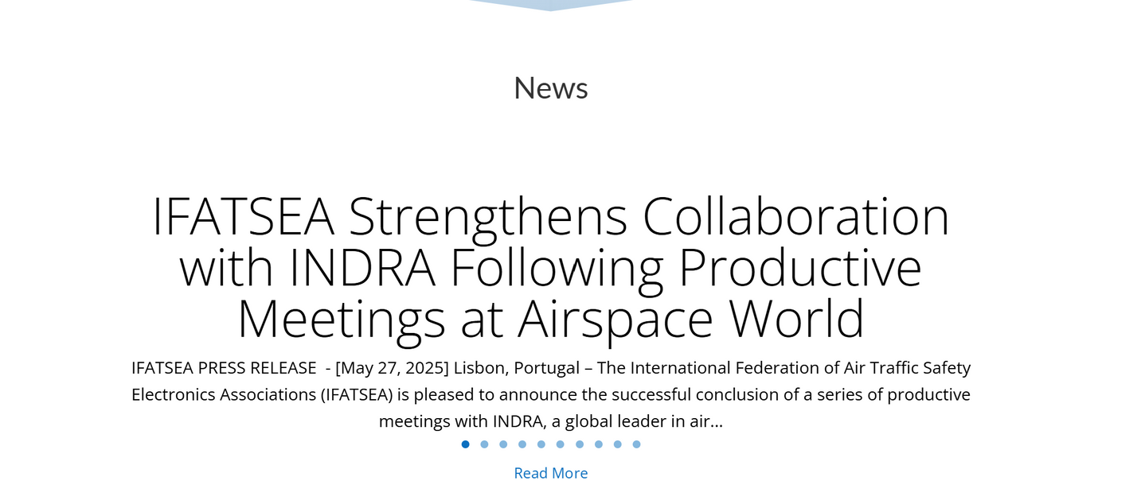
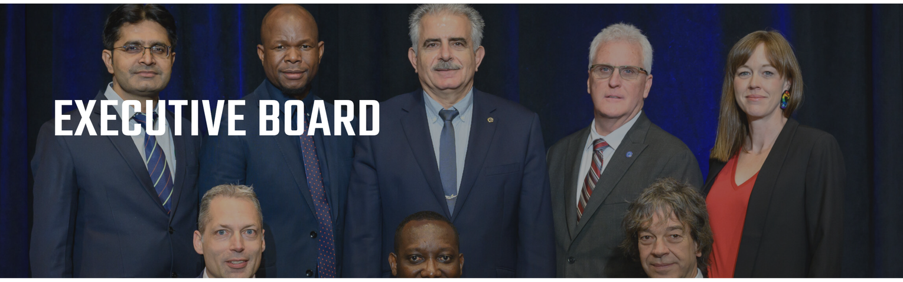
-
Website
Up to date
Press releases
Governance
Notes:
Throughout the past four years these factors have and continue to have a large effect on the ATSEPs in Canada.
I will go over each one in a bit more detail.

Slide 7
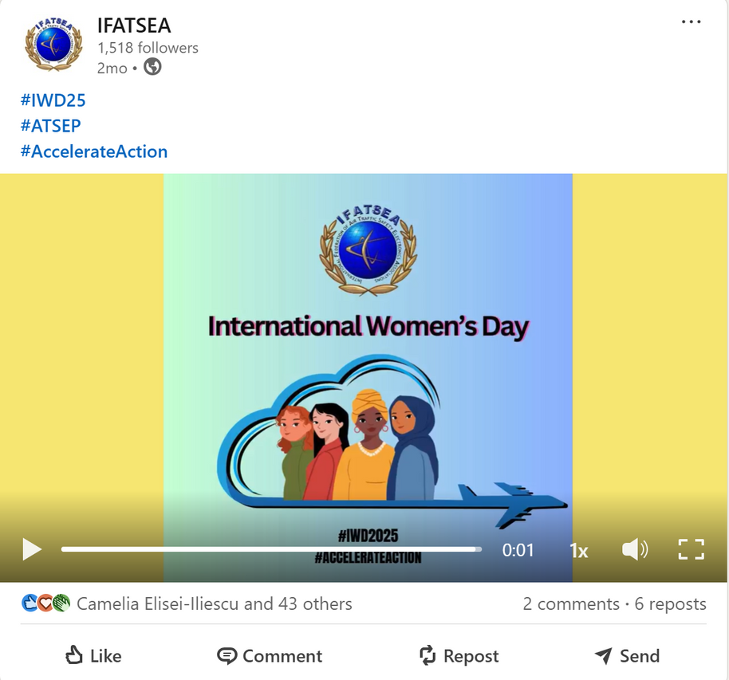
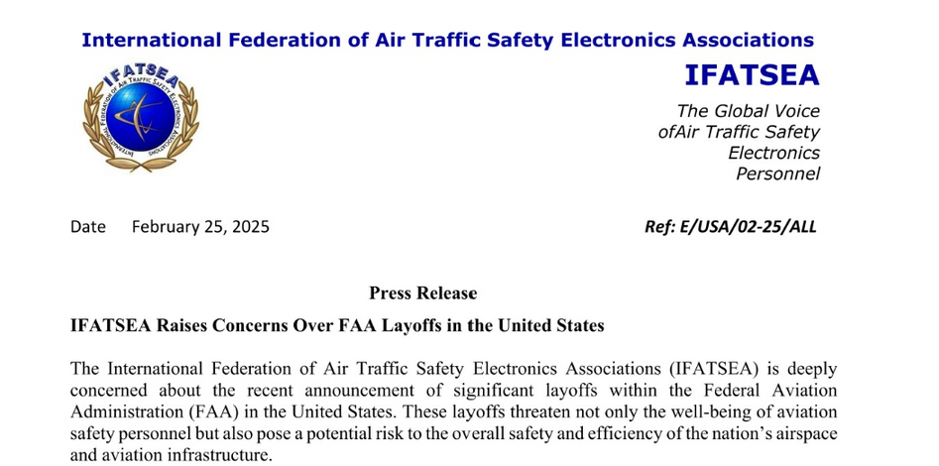
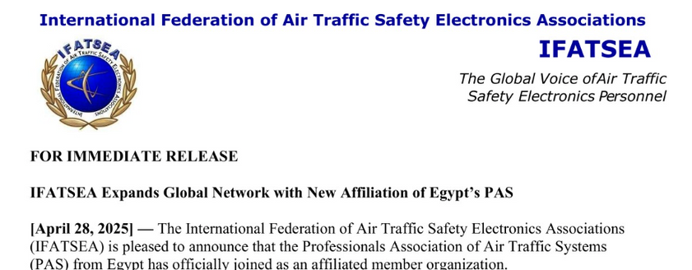
Social Media
Notes:
Pandemic-
1. The ANSP obviously suffered hugely during the pandemic. As we all know traffic went down to basically 0.
Because of this the ANSP asked the unions to agree to defer any negotiated wage increases for the upcoming 3 years which was the length of the contract, and in return they would not proceed with a workforce adjustment.
This request went for a membership vote which caused an enormous uproar from the membership, in every way you can imagine.
IBEW voted the deferral down. Only one union voted to defer their wages.
- Subsequently we went through the WFA and lost approximately 40 members
- many were hired back afterwards
- but like many organizations the membership has faced a lot of uncertainty and fear over their jobs and their economic realities.
We were able to work with the employer to reintegrate the returning employees pretty seamlessly for seniority and vacation entitlements, but there were losses for those ATSEPs as the pension laws in canada would not allow for a continuous service bridge for their pensions upon their return to Nav employment.
The Workforce adjustment had a huge effect on our bargaining round and the team spent a significant amount of time reworking the employment displacement articles so if the situation were to recur there would be less uncertainty in terms of process.
Overall the choices of the ANSP, necessary or not, during the pandemic served to unravel any trust the membership had started to build towards the employer and as a result the relationship and the workplace culture has definitely suffered and as a result the local has had its work cut out for us to be able to move forwards.

Slide 8


Recruitment Materials
Corporate membership > corporate sponsors
New Affiliate
Notes:
Pandemic-
1. The ANSP obviously suffered hugely during the pandemic. As we all know traffic went down to basically 0.
Because of this the ANSP asked the unions to agree to defer any negotiated wage increases for the upcoming 3 years which was the length of the contract, and in return they would not proceed with a workforce adjustment.
This request went for a membership vote which caused an enormous uproar from the membership, in every way you can imagine.
IBEW voted the deferral down. Only one union voted to defer their wages.
- Subsequently we went through the WFA and lost approximately 40 members
- many were hired back afterwards
- but like many organizations the membership has faced a lot of uncertainty and fear over their jobs and their economic realities.
We were able to work with the employer to reintegrate the returning employees pretty seamlessly for seniority and vacation entitlements, but there were losses for those ATSEPs as the pension laws in canada would not allow for a continuous service bridge for their pensions upon their return to Nav employment.
The Workforce adjustment had a huge effect on our bargaining round and the team spent a significant amount of time reworking the employment displacement articles so if the situation were to recur there would be less uncertainty in terms of process.
Overall the choices of the ANSP, necessary or not, during the pandemic served to unravel any trust the membership had started to build towards the employer and as a result the relationship and the workplace culture has definitely suffered and as a result the local has had its work cut out for us to be able to move forwards.

Slide 9
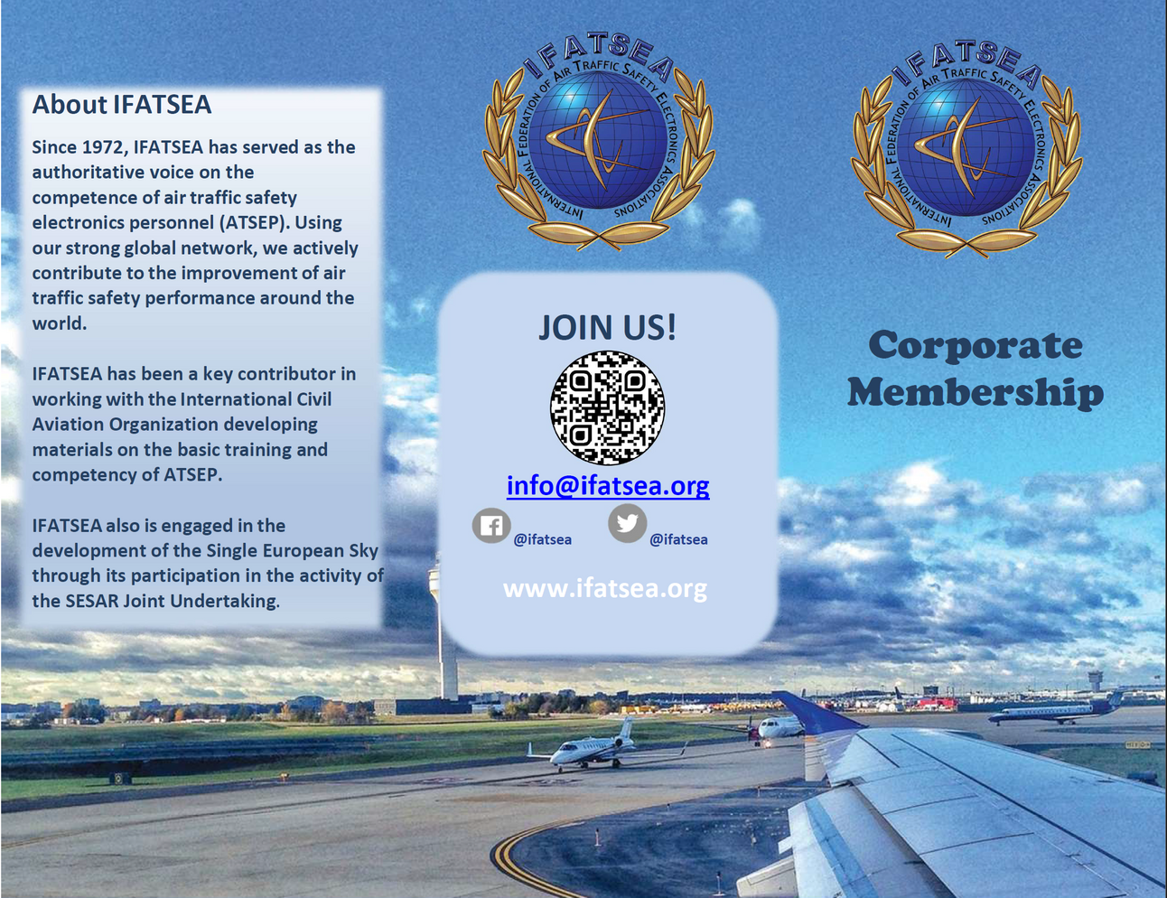
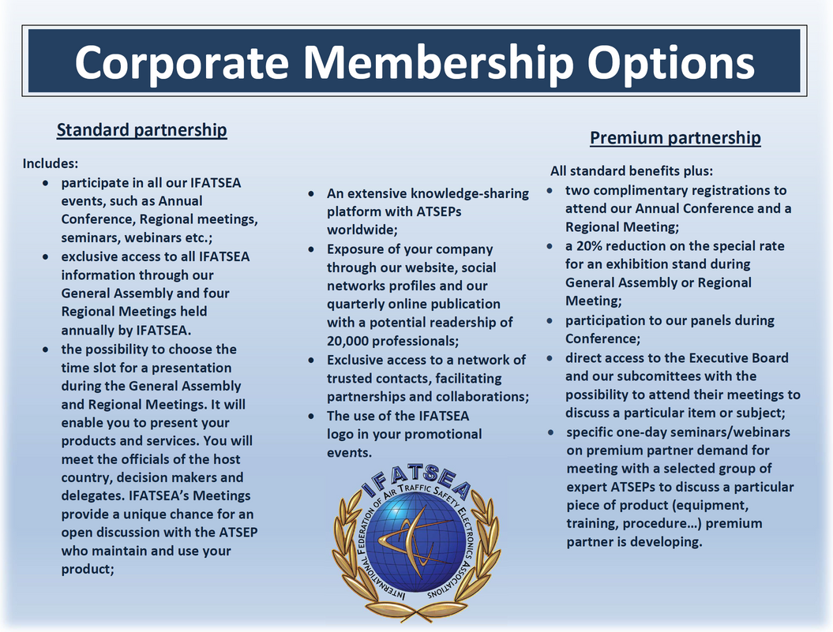
Affiliate brochure coming soon!
Notes:
Pandemic-
1. The ANSP obviously suffered hugely during the pandemic. As we all know traffic went down to basically 0.
Because of this the ANSP asked the unions to agree to defer any negotiated wage increases for the upcoming 3 years which was the length of the contract, and in return they would not proceed with a workforce adjustment.
This request went for a membership vote which caused an enormous uproar from the membership, in every way you can imagine.
IBEW voted the deferral down. Only one union voted to defer their wages.
- Subsequently we went through the WFA and lost approximately 40 members
- many were hired back afterwards
- but like many organizations the membership has faced a lot of uncertainty and fear over their jobs and their economic realities.
We were able to work with the employer to reintegrate the returning employees pretty seamlessly for seniority and vacation entitlements, but there were losses for those ATSEPs as the pension laws in canada would not allow for a continuous service bridge for their pensions upon their return to Nav employment.
The Workforce adjustment had a huge effect on our bargaining round and the team spent a significant amount of time reworking the employment displacement articles so if the situation were to recur there would be less uncertainty in terms of process.
Overall the choices of the ANSP, necessary or not, during the pandemic served to unravel any trust the membership had started to build towards the employer and as a result the relationship and the workplace culture has definitely suffered and as a result the local has had its work cut out for us to be able to move forwards.

Slide 10
-
Current Challenges
Email server - account owned by an outside entity.
  ETA to resolve = < 1 week as of 2025-06-05
Facebook - account has been hacked and password changed so IFATSEA has no access.
  ETA to resolve = TBD
Notes:
We have been told that the membership can be expected to grow according to the employers projections over the coming few years by at least 100 ATSEPs.
Tec0 - 50
Tec1 - 230
Tec2- 230
Tec3- 90

Slide 11
THANK YOU
SO MUCH!

