Slide 1
2024 AARM

Slide 2
IFATSEA
Overview
Intro to ATSEP
Intro to ICAO
Working with ICAO
Working Papers
ICAO ANC
Notes:
Overview page

Slide 3
IFATSEA
Air Traffic Safety Electronics Personnel (ATSEP)
Is the recognized ICAO terminology for personnel proven to be competent in the installation, operation and/or maintenance of a Communications, Navigation, Surveillance/Air Traffic Management (CNS/ATM) systems.
Comprise engineers, technicians, technologists, and computer hardware and software specialists who are responsible for the specification, procurement, installation, calibration, maintenance, testing and certification of ground electronic and computer systems used to help control aircraft movements.
Notes:
Intro to ATSEP
We do CNS and ATM, installation, operation, and maintenance
Entry to the job comes from various backgrounds, from technicians to university graduates. Hiring requirement varies from ANSP to ANSP.

Slide 4
The Foundation of ICAO
Notes:
In 1947, 52 countries came together and agreed on certain principles and arrangements in order that international civil aviation may be developed in a safe and orderly manner and that international air transport services may be established on the basis of equality of opportunity and operated soundly and economically.
The SARP’s Standards And Recommended Practices are technical specifications adopted by the Council of ICAO and this is where licensing falls for pilots, air traffic controller and aircraft mechanic’s. These are mandatory requirements.

Slide 5
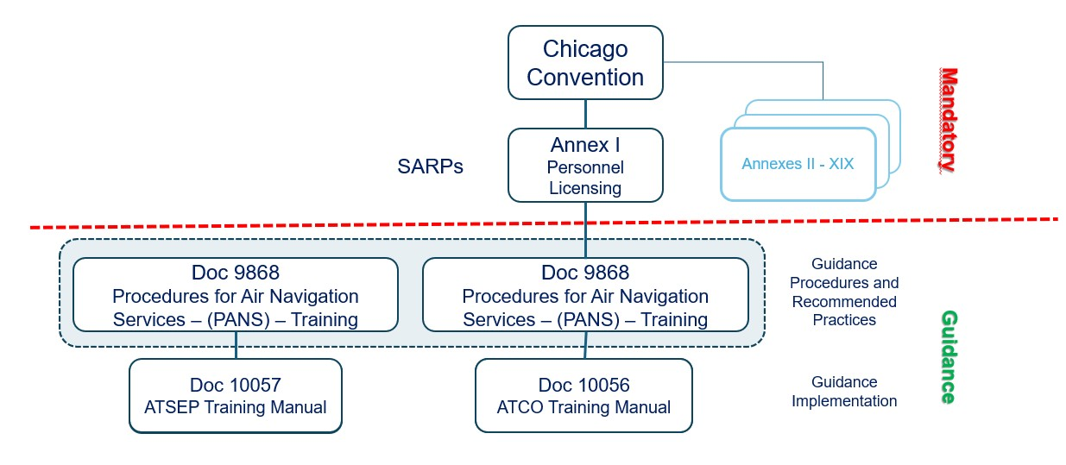
ICAO Document Hierarchy
Notes:
Below the red dotted line, you see the ICAO Document 9868-Procedures for Air Navigation Services-Training : This PANS contain material that provides for the uniform implementation of the training required for pilots, controllers, mechanics and ATSEP
The ATSEP training manual 10057 replaced the old 7192 which was developed by IFATSEA and ICAO around 2000.
As part of the NGAP Project, these manuals have been updated and IFATSEA had a strong presentence and contributed to the update of PANS TRG manual 9868 and creation new ATSEP Training Manual 10057.

Slide 6
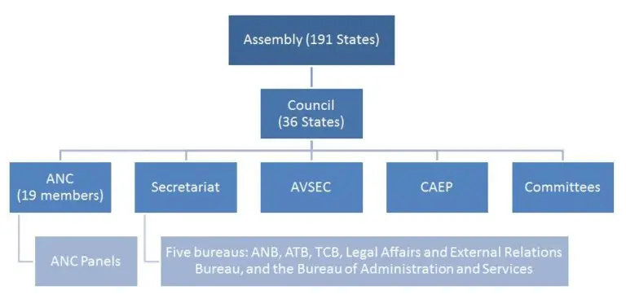
IFATSEA
Notes:
The important part of ICAO to IFATSEA is the ANC and secretariat
ANC has 19 voting members and 9 members from the industry as observers
The ANC manages the technical part of the ICAO Work Programs
ANC oversees 17 of the 19 Annexes to the Chicago Convention, recommend SARPs adoption/amendment relating to the Annexes.
ANC normally meets nine weeks each year to address those technical matters. Each session conducts preliminary reviews (coming most of the time from Panels’ work), final reviews (to include comments from States and International Organizations following the circulation of an ICAO State Letter)
as well as Panels, PIRGs, RASGs and other reports.
Secretariat made up of five bureaus reporting directly to the Secretary General

Slide 7
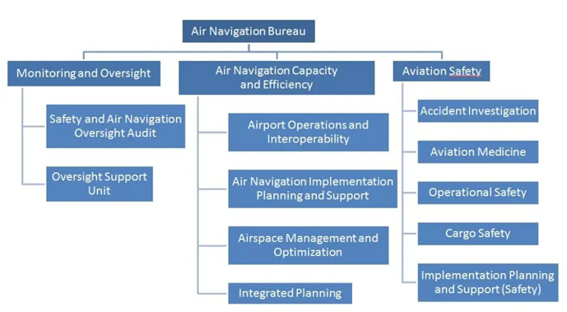
Notes:
The following chart describes the hierarchy within the ANB and its different sections.
The ANB touches four different elements:
Policy and Standardization
Safety and Infrastructure Monitoring
Safety and Infrastructure Analysis
Safety and Infrastructure Implementation
The ANB is also the focal point for the development and amendment of the Global Air Navigation Plan Portal (GANP) and the Global Aviation Safety Plan (GASP): these two global plans are affecting all sections of the Bureau, but also all the Regional Offices.

Slide 8
IFATSEA
WHERE DOES IFATSEA GET INVOLVED?
During The Development Of SARPs And PANS...
Secretariat
International
Organization
Meetings Panels and
Committees
Contracting
States
Assembly
Council
Secretariat
ANC
IFATSEA can introduce papers
Proposal for Action
IFATSEA Representative
IFATSEA Participation
ANC
IFATSEA Representative
IFATSEA Participation
ANC Panel
Secretariat
Divisional Meeting
IFATSEA can raise issues directly to Secretariat
Study Group
IFATSEA Participation
IFATSEA Representative
Technical Review
ANC Preliminary Review
Notes:
Discuss where IFATSEA can contribute

Slide 9
IFATSEA
WHERE DOES IFATSEA GET INVOLVED?
During The Review Process..
ANC Preliminary Review
IFATSEA Representative
Consultation via
State Letter
Contracting States
International Organizations
Secretariat
IFATSEA ‘s response to State Letter
Secretariat Analysis
IFATSEA Representative
ANC Final Review
Notes:
Once a Proposal for Amendment (PFA) it can be either a new or amended SARP - is deemed mature enough to be sent for consultation to States, it is presented to the ANC in what is called the Preliminary Review.
Preliminary Review completed PFA is then submitted to States and International Organizations for comments in an official ICAO State Letter for comments. ( 3 months to respond).
Comments are analyzed by the Secretariat and presented in a working paper to the ANC for Final Review.
Modifying an Annex is presented to the Council by the ANC for adoption, in a Report to Council. By the ANC for adaptation.
PANS are approved directly by the ANC without the intervention of the Council.

Slide 10
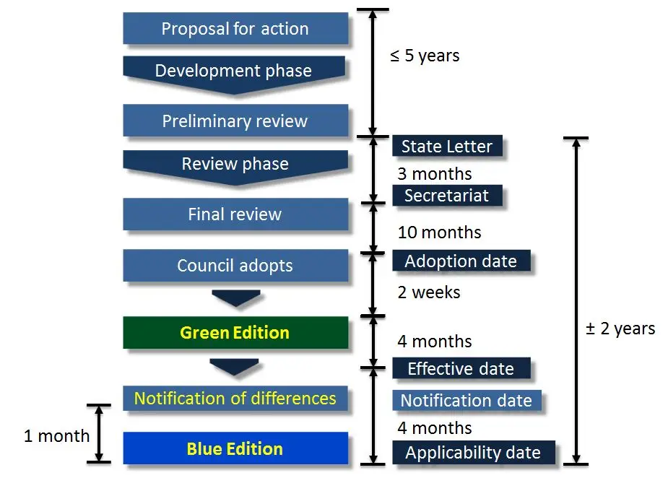
From START TO FINISH
Notes:
ICAO process time frame takes up to 5 to 7 years.

Slide 11
IFATSEA
Working with ICAO
NGAP: Next General Aviation Professionals
Participate in creation/update of ICAO Docs 10057/9868
Key participants in development of workshop in support of above docs
Key participants in delivery of workshops globally (at regional offices)
CBT Task Force
Refine ICAO Doc 10057
Notes:
IFATSEA accomplishments over the last 10 years as shown
Panels/workgroups IFATSEA involvement: NGAP and CBT Task Force
Lots of time and effort in creation and support of Doc 10057 and PANS 9868

Slide 12
IFATSEA
Working with ICAO
ICAO Global Aviation Training
At ICAO’s request, participated in an ICAO audit of a Basic Training course (ref 10057)
ICAO Personal Training Licensing Panel (PTLP)
Introduced Working Paper: PTLP/4-WP/32:Proposal to Work on Amendment to DOC 10057
Notes:
Participated in audit of NCAT Basic Training course.
PTLP is mostly made of those included under Annex-1 Pilot, Controllers, Aircraft Maintenance Technicians etc.
IFATSEA is an observer of the PTLP, and we introduced : PTLP/4-WP/32

Slide 13
IFATSEA
Working Papers
Working Paper 229: Required Successful Achievement OF Basic Training Objectives by all ATSEP
Working Paper 122: Update Existing ATSEP Cybersecurity Training Objectives and Development of New ATSEP Cybersecurity Training Objectives
Notes:
Intro to Working Papers
2018, 2022, two working papers accepted by ICAO

Slide 14
IFATSEA
Working Paper 229
REQUIRED SUCCESSFUL ACHIEVEMENT OF BASIC TRAINING OBJECTIVES BY ALL ATSEP
Initial training, as described in Doc 10057, is made up of Basic Training and Qualification Training.
In the Initial Phase of training for ATSEP (as described in Doc 10057), the first part of training is Basic Training.
The Basic Training is designed to provide underpinning knowledge for all further training.
Appendix B of Doc 10057 of the manual provides recommended training objectives for a basic training course.
Doc 10057 states that all ATSEP should successfully complete Basic Training.
Notes:
WP 229 Intro, background.
Discuss Doc 10057 structure, emphasis on Appendix B training objectives.

Slide 15
IFATSEA
Working Paper 229
REQUIRED SUCCESSFUL ACHIEVEMENT OF BASIC TRAINING OBJECTIVES BY ALL ATSEP
It was discovered that the level of initial training being provided, at that time, was not consistent.
Recent discussions with IFATSEA affiliates have indicated that the level of initial training is still inconsistent.
Notes:
Problem – Basic Training, as defined by the objectives in Doc 10057 Appendix B, not being consistently applied.

Slide 16
IFATSEA
Working Paper 229
Training Benefit
Provides the underpinning knowledge for all ATSEP training.
Builds the foundation of understanding of the local and global impact of the work that ATSEP perform.
Provide harmonization for all ANSP basic training and basic competencies.
Provide ATSEP with a sense of inclusion in the global aviation community, as many are currently feeling left out.
Notes:
WP 229 Benefits, form working paper as shown
Emphasis on Harmonization of training.

Slide 17
IFATSEA
Working Paper 122
UPDATE EXISTING ATSEP CYBERSECURITY TRAINING OBJECTIVES AND DEVELOPMENT OF NEW ATSEP CYBERSECURITY TRAINING OBJECTIVES
The worlds air navigation systems are aggressively interconnecting global air traffic digital system and services.
ANSPs must rely on cyber security to be at their core to ensure the integrity and safety of the air traffic operation.
ATSEP cyber security training are inconsistent and at worst ad hoc.
Notes:
Intro to WP 122, background
As we all know the worlds air navigation systems are becoming more digital and connected globally.
As this technology advances the training of the ATSEP is falling behind in cyber security or non-existing.

Slide 18
IFATSEA
Working Paper 122
UPDATE EXISTING ATSEP CYBERSECURITY TRAINING OBJECTIVES AND DEVELOPMENT OF NEW ATSEP CYBERSECURITY TRAINING OBJECTIVES
The ATSEP have a critical role coordinating the recovery air traffic system while ensuring ATM systems remain safe.
The ATSEP, who are responsible for the technical systems should also be trained cyber security.
Notes:
The ATSEP have a critical role coordinating the recovery air traffic system while ensuring ATM systems remain safe.
The ATSEP, who are responsible for the technical systems should also be trained cyber security.

Slide 19
IFATSEA
Working Paper 122
Training Benefits
Improved security posture: cybersecurity training equips ATSEPs with the knowledge and skills needed to identify and mitigate cyber threats.
Reduced vulnerabilities: cybersecurity training helps ATSEPs and ANSPs identify and address vulnerabilities in their systems and networks.
Notes:
WP 122 Benefits

Slide 20
IFATSEA
Working Paper 122
Training Benefits
Threat awareness: training helps ATSEPs stay informed about the latest cyber threats and attack techniques.
Cost savings: Investing in cybersecurity training can ultimately save ANSPs money. Preventing a data breach or cyberattack is typically less expensive than dealing with the aftermath.
Notes:
WP 122 Benefits

Slide 21
Working Paper PTLP/4-WP/32
Discussion with the President of the ANC pushed WP-229 and WP-122 to the PTLP
PTLP/4-WP/32 asks the PTLP to accept additional work addressing WP-229 and WP-122
As an observer IFATSEA and is not a voting member
This paper was accepted for IFATSEA to develop a job card to be presented at PTLP/5.
Notes:
This paper asks the PTLP to consider adding a new work program to propose amendments to Air Traffic Safety Electronics Personal (ATSEP) initial basic training, to update all the phases of ATSEP training to include cybersecurity, Appendix B training objectives and to develop a job card to be presented at PTLP/5.
PTLP will be the stewards of the PANS-TRG 9868 document. The PTLP can recommend changes to Annex 1
IFATSEA needs to ensure participation in the PTLP CBTA workgroup activities

Slide 22
Air Navigation Commission (ANC)
IFATSEA is a recognized observer to the ANC
Direct interaction with commissioners
Direct interaction with panel secretariats
Participate in reviewing panel reports to ANC
Ability to intervene during reports to ANC
Ability to present working paper directly to ANC
Participate in the future of aviation
Notes:
The ANC is the most important contact we have within ICAO
We do not have voting privileges

Slide 23
IFATSEA
Summary
IFATSEA IS UNDERREPRESENTED AT ICAO
To move forward we need to be visible at ICAO as much as possible!!!!
It takes a team to be seen, not one !!!!

Slide 24
IFATSEA
THANK YOU ADTEMA
Many thanks to ADTEMA members for
for the hospitality of their country.
Special Thanks to Angel for all our arrangements.

Slide 25
Notes:
End

