Slide 1

WOMEN'S COMMITTEE REPORT
AARM CUN 2025

Slide 2



Slide 3
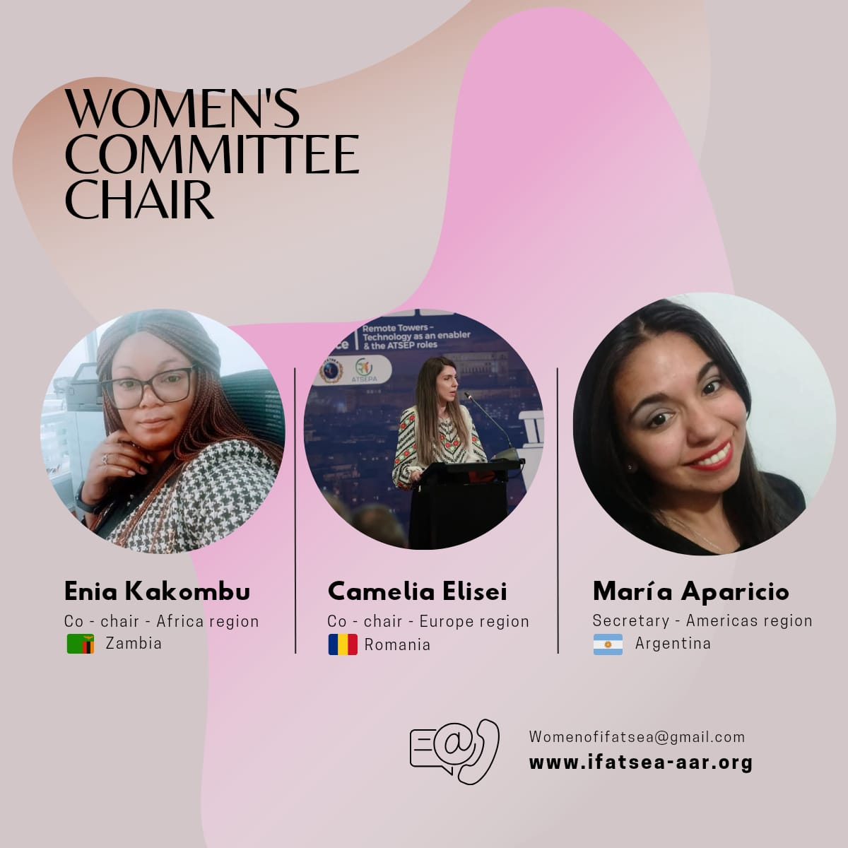

Slide 4
OUR MISSION
Purpose:
To create a safe an inclusive environment for women in the feild of aviation technical services. Ensuring they voices are hear, valued, and supported.
The committee aims to work with IFATSEA to encourage meaningful support and empowerment for women across the organization.

Slide 5
OUR MISSION
Scope:
Foster a professional network that supports the advancement of women across all ATSEPs roles.
Identify and address barries to participation, leadership, and recognition for women in ATSEP roles.
Increasing the visibility and representation of ATEP women in decision – making roles at national and international levels
Promote policies and initiatives that enhance gender equality and workplace inclusivity for all women working as ATSEPs.

Slide 6
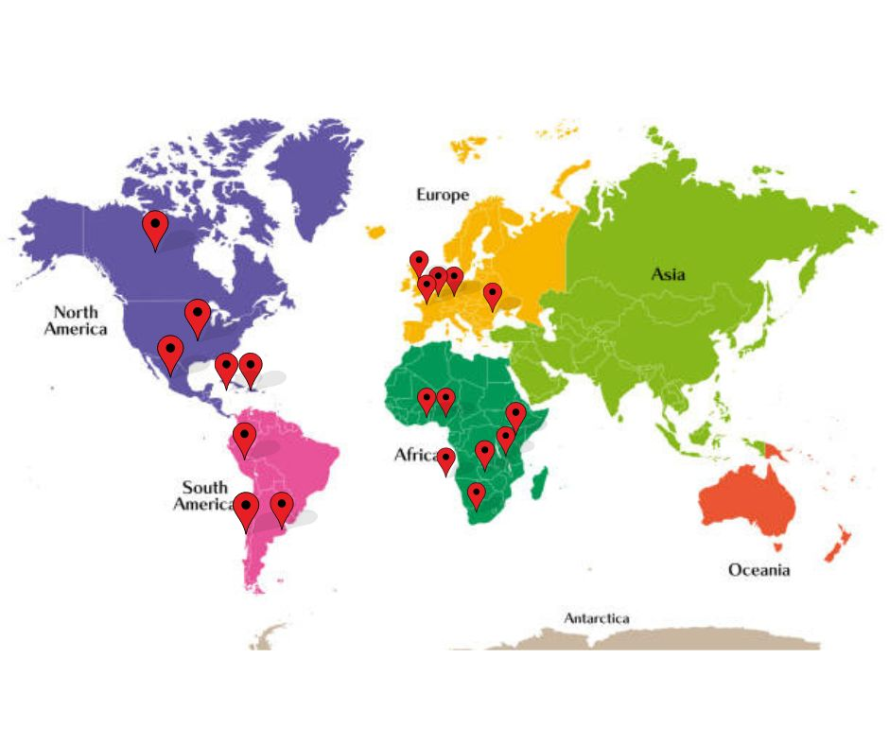
MEMBERSHIP
All ATSEP Women are welcome in this Committee
International Composition – No regional committee meetings

Slide 7
OUR WORK
Quaterly meetings:
Regular discussions to share progress, identify challenges, and plan initiatives supporting women in aviation technical services.
2. International Collaboration:
Participated in join efforts with IFALPA, IFAIMA, IFATCA and IFISA for 2025 International women's day under the shared theme #AccelerateAction – Highlighting global solidarity and shared commitment to gender equity
3. Survey
Collecting information across the world to know the challenges we are going to face on like recruitment, retention and support.

Slide 8
OUR WORK
4. Social Media
The Women's committee has a spot in the AARM website and also is actively working with the social media committee
5. Awareness
Increase visibility of ATSEP work outside our organization and educate our IFATSEA members on our challenges.
6. Education
Provide educational opportunities for our members using social media to share event details for opportunities to receive training.

Slide 9
IWD IFATSEA

